Slide 1

Senior Design Project by: Katie Canedo, Alexis Haley, Aveisha Maharaj, Marko Vukasinovic and Kayla Mastin
Notes:
Kayla

Slide 2


Slide 3

Our Vision & Goal
To have a "Connected Mattress" with sensors and circuits
Allow healthcare providers the ability to continuously monitor their patients
Can be alerted when patients vitals are changing too rapidly or fall below a certain threshold
Benefit understaffed hospitals
Comfort for patients
Time logs cut in half (CNA, heart rate, pulse ox, circulation)
Notes:
The goal of our project is to create a hospital mattress designed for ICU patients that incorporates sensors within
This goes along with an app to connect to the bed via Bluetooth to be able to alert nurses of rapid changes in vitals
This will also assist CNAs who are understaffed in collected basic vitals such as heart rate and pulse oximetry as well as preventing bed sores
We’re also incorporating a few sensors for the patients’ comfort such as temperature control and massage pumps

Slide 4
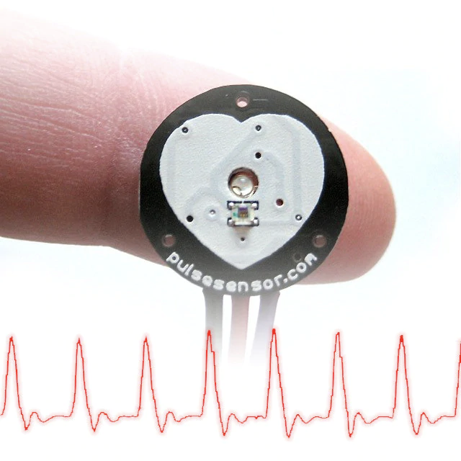
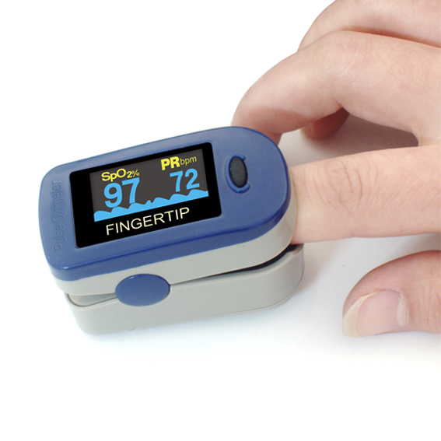
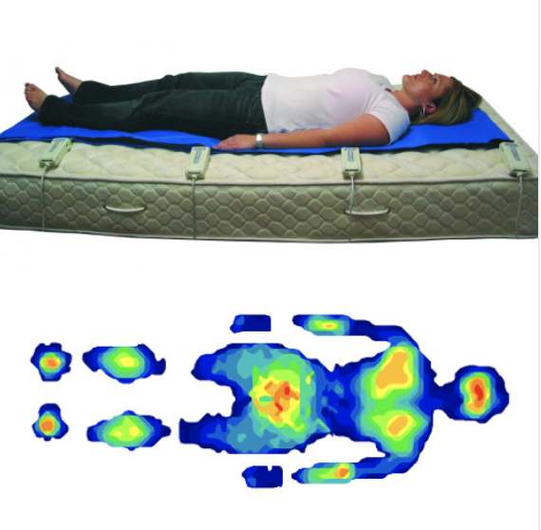
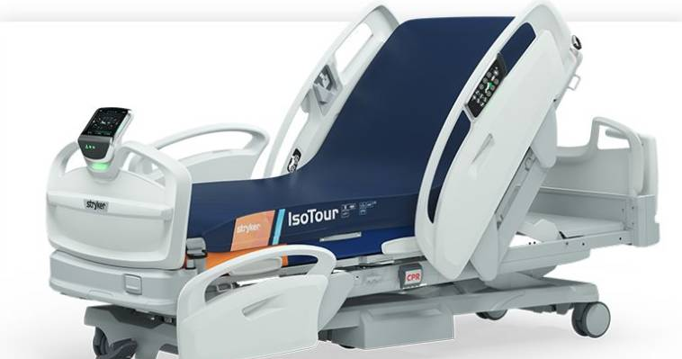
Overall Idea
Pressure sensors (weight + distribution): Tekscan body pressure mapping
Heart rate sensors: Reflection-type pulse sensors / Optical sensor
Pulse O2 monitor: Transmissive pulse oximetry
Bed Alarm: Sensor to detect when patient is continuously moving / trying to get up
Automatic heater/cooler: Temperature sensor
Circulation (prevent blood clots): Intermittent pneumatic compression pumps
Massager/sleep quality analyzer: 3 axis accelerometer sensor
Notes:
These are the basic ideas for sensors we plan to incorporate into our design
Pressure sensors for body pressure mapping which will provide things like weight distribution and sleep analysis throughout the night
Heart rate and pulse oximetry sensors to provide around the clock updates of basic vitals
Bed alarm sensor to detect when the patient is rapidly moving (which could indicate convulsion activity) or when a patient on bed rest is trying to get up
Temperature sensors that will be adjustable in 3 regions
Circulation compression pumps combined with massager to prevent bed sores and rotate bed bound patients

Slide 5
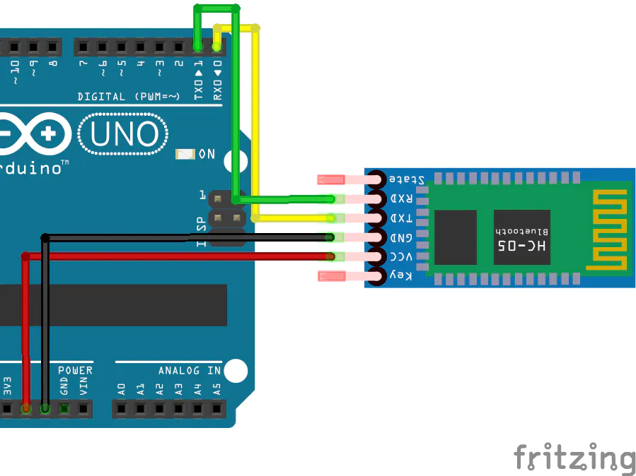
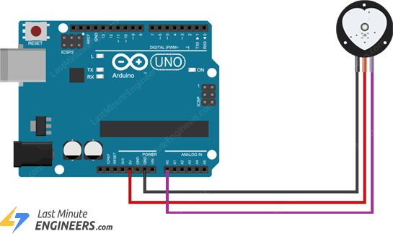
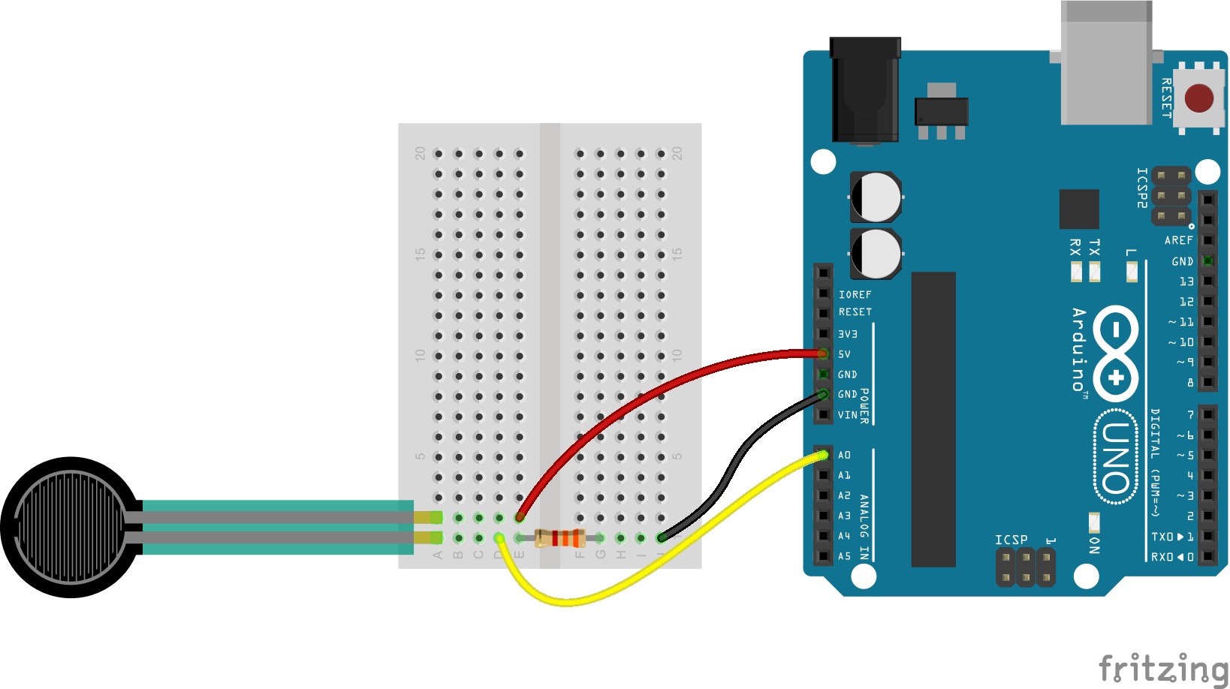
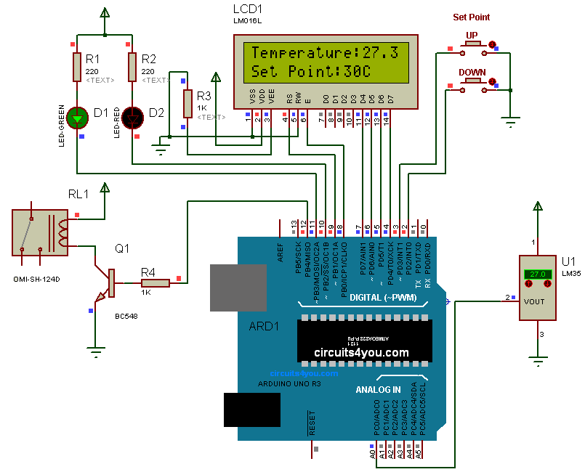
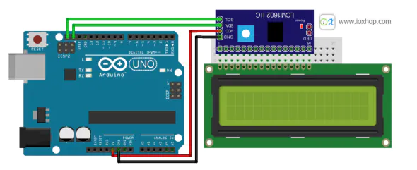
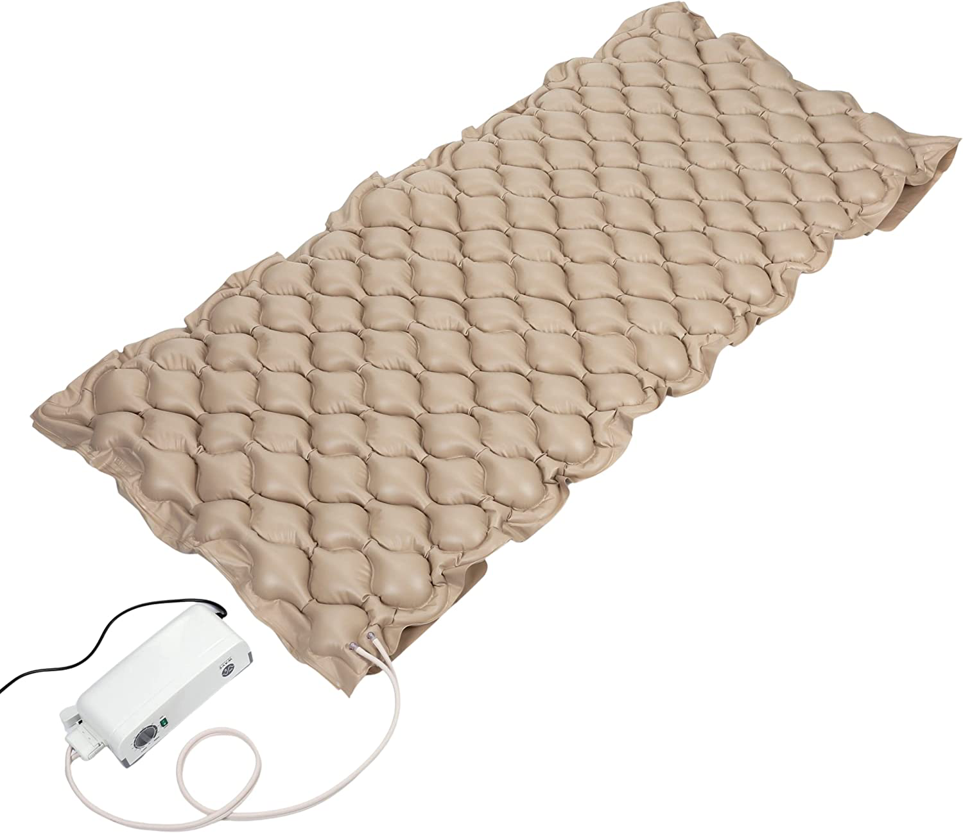
Circuits
Notes:
- Not finalized – versions of all the circuits and components we would like to use
Heart rate and pulse ox, temperature, body pressure mapping, bed alarm, bluetooth connection, massager and circulation pumps
https://www.amazon.com/Wave-Medical-Premium-Alternating-Pressure/dp/B08BS4XNHM/ref=asc_df_B08BS4XNHM/?tag=hyprod-20&linkCode=df0&hvadid=563617515022&hvpos=&hvnetw=g&hvrand=10564091214252336566&hvpone=&hvptwo=&hvqmt=&hvdev=c&hvdvcmdl=&hvlocint=&hvlocphy=9011817&hvtargid=pla-1600882241450&psc=1

Slide 6
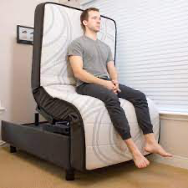




Circuits
Heartrate / Pulse Ox Sensor
Bed Alarm
Arduino
Protoboard
Temperature Sensor
Circulation Pumps
Massager
- separate system on the bed frame with manual buttons for raising / lowering the bed
Patient Name / Room #
Pressure Mapping Sensor
Sleep Analyzer
72 bpm
96 %
25°C
Set to: 25°C
Warnings:
None
Last at 9:42
Notes:
Rather than using separate Arduinos for each sensor, we plan to use one since Arduino and have the input as one protoboard that contains all our sensors and the output be an app for the nurses station
The app will allow users to interact and click on various symbols for more detail about the patients vitals (ex. Click the heart, shows the ECG output or click the body icon, shows the body pressure map)
If we have time, we also would like to build a metal bed frame that folds to a sitting position for ease of ICU patients getting into and out of the bed

Slide 7

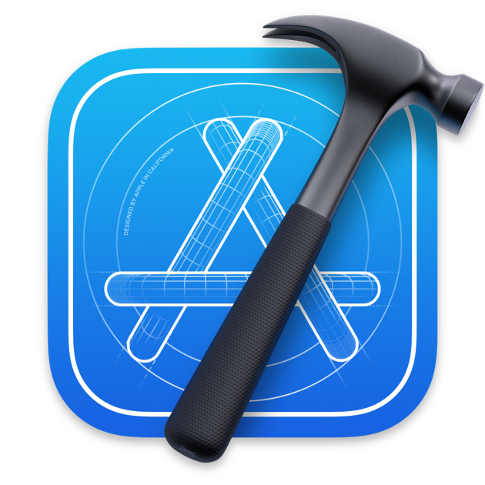
Software Development
Patient Name / Room #
72 bpm
96 %
25°C
Set to: 25°C
Arduino
Warnings:
None
Last at 9:42
XCode/Swift
C++
App Platform: IOS
IDE: XCode
Programming Language : SWIFT
Bluetooth Communication with Arduino
All the incorporated sensors can be controlled with in built C++ libraries
The date is to be in JSON format in order to be sent to the app over Bluetooth
Notes:
- Each of the aforementioned sensors comes with specific data gathering libraries available which will be used in order to gather acquired data in one place. We will then use a different script to send the collected data over bluetooth, to be received over the phone app
The app will allow users to interact and click on various symbols for more detail about the patients vitals (ex. Click the heart, shows the ECG output or click the body icon, shows the body pressure map)
If we have time, we also would like to build a metal bed frame that folds to a sitting position for ease of ICU patients getting into and out of the bed

Slide 8
Expected Software Technical Difficulties
Lack of experience with XCode/SWIFT
Integrating incompatible sensor libraries in on large data packet
Lack of experience with setting up Bluetooth communication
Communication between the hardware and the software team

Slide 9

Team Organization
Team Lead:
Hardware – Katie & Aveisha
Software – Kayla & Alexis & Marko
Fiscal Officer: Alexis
Testing Coordinator: Aveisha
Notes:
katie

Slide 10

Gantt Chart
(click to link)
Notes:
katie

Slide 11
Budget
Total: $480 + shipping
Pressure sensor ~ $100
Tekscan body pressure model
Temperature sensor ~ $30
Button Controller ~ $15
Heart rate Sensor / Pulse Ox ~ $60
Bed Alarm Sensor ~ $30
Massager ~ $60
Arduino Kit~ $30
Protoboard Kit ~ $35
Safety Measures ( circuit breaker & thermal tape) ~ $40
Wireless Monitor (Connect to iPads)
Breadboard for Testing (FREE!)
Metal Bed Frame ~ $60?
Mattress from Housing for Testing (Free!)
Final Mattress ~ $80
Notes:
Estimated budget projections, subject to change based on availability of some sensors
Currently already have a mattress from FL tech housing, next week we plan on cutting it open to get an idea of how the sensors will be places and in which layers
Heart rate sensor: https://www.amazon.com/PulseSensor-com-Original-Pulse-Sensor-project/dp/B01CPP4QM0/ref=asc_df_B01CPP4QM0/?tag=hyprod-20&linkCode=df0&hvadid=508977605709&hvpos=&hvnetw=g&hvrand=15824051441018963270&hvpone=&hvptwo=&hvqmt=&hvdev=c&hvdvcmdl=&hvlocint=&hvlocphy=9011817&hvtargid=pla-1362130091700&psc=1

Slide 12


Execution Plan (For Fall 2022)
Simulate circuits
Build one circuit including all sensors on a simulator
Build and Test the circuits (pressure, heart rate / pulse ox, bed alarm)
Write code for each sensor
Develop the App
Notes:
Right now we are in the process of developing one final circuit diagram in either KiCad or Multisim
Since we are unable to order any parts until October we are going to run simulations of each circuit to ensure smoother testing once we have all the parts
Also writing code for each circuit one at a time and once we have tested all circuits individually, we will put them together
Begin the basics of app development such as formatting / design

Slide 13

Hardware Milestones
Obtain mattresses (DONE-ish)
Have a layout of all circuits to be used (halfway:) done by 9/15 )
Building each circuit
Forming one circuit with all sensor components
Testing the final circuit in the mattress
Making mattress presentable
Testing the circuits in the mattress
Simulate testing of all circuits (done by 9/25)
Notes:
FL tech housing gave us 1 mattress, but ideally, we would like 3-4 so we are waiting to see if they have any more, they can give us, if not we plan to reach out to other schools
Hospitals will not give us mattresses due to infection control policies
As mentioned, we are working on the final circuit layout and simulation testing of all of them
Once we are able to order parts we will first build the circuit on a breadboard, ensure it works along with the code then test it out in the mattress
Finally we will incorporate all sensors into one final piece and test it and make sure the mattress is usable / presentable
We have already filled out the project registration and plan to finish the risk assessment form this weekend, and we are waiting on IRB approval for human testing before we can fill out the safety form

Slide 14
Software Milestones
Choose Necessary Software tools
Set up Sensor Code for each sensor
Develop Bluetooth Communication
User Testing
Integration & Unit Testing
Develop IOS Application
Milestone 1
Milestone 2
Milestone 3
Notes:
FL tech housing gave us 1 mattress, but ideally, we would like 3-4 so we are waiting to see if they have any more, they can give us, if not we plan to reach out to other schools
Hospitals will not give us mattresses due to infection control policies
As mentioned, we are working on the final circuit layout and simulation testing of all of them
Once we are able to order parts we will first build the circuit on a breadboard, ensure it works along with the code then test it out in the mattress
Finally we will incorporate all sensors into one final piece and test it and make sure the mattress is usable / presentable
We have already filled out the project registration and plan to finish the risk assessment form this weekend, and we are waiting on IRB approval for human testing before we can fill out the safety form

Slide 15
Milestone 1
Compare and select technical tools for Developing application, Controlling sensors and gathering their input, Bluetooth communication
Provide small ("hello world") demo(s) to evaluate the tools for Developing application, Controlling sensors and gathering their input, Bluetooth communication
Resolve technical challenges: Choosing and implementing multiple sensors, Building basic framework for the application, Decide on transfer of data issue
Compare and select collaboration tools for software development, documents/presentations, communication, task calendar
Create Requirement Document
Create Design Document
Create Test Plan and Datasets

Slide 16
Milestone 2
Implement, test, and demo Basic App Layout and Data Display
Implement, test, and demo Bluetooth Communication between Arduino and App

Slide 17
Milestone 3
Implement, test, and demo Pressure Sensors
Implement, test, and demo Heart Rate Sensors
Implement, test, and demo Temperature Sensors
Implement, test, and demo Bed Alarm Sensors
Implement, test, and demo Circulation Pumps

